Slide 1
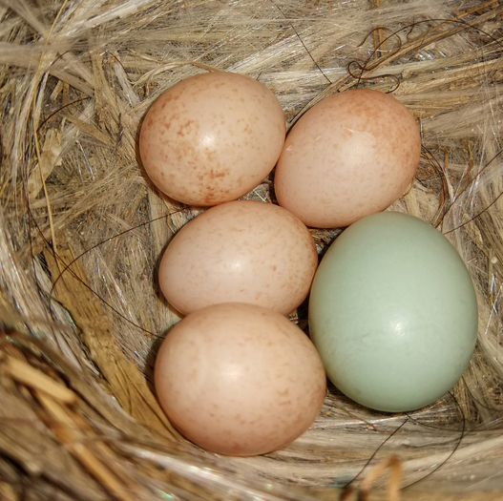
Cuckoo Hashing
Madhav Lata
Nikhil Jain
Sambuddha Chakrabarti

Slide 2
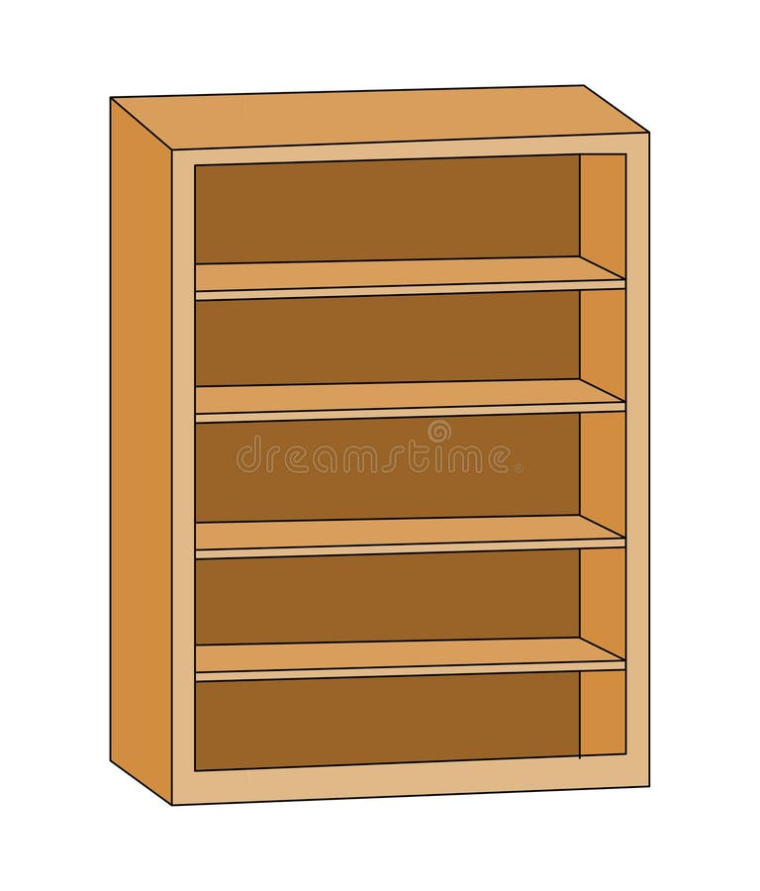

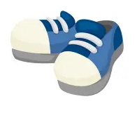




The Shoe Problem
Children must not be late for next class
Teacher has to store shoes in some shelves
Teacher knows about ‘shoe’ hashing techniques
Require structure that has expected constant insertion time and constant retrieval time

Slide 3
The Cuckoo way
Teacher has access to universal family of shoe hash functions
Given a shoe, the shoe hash function tells teacher which rack the shoe belongs in O(1)
Teacher uses two shelves with two distinct hash functions to store shoes

Slide 4

Insertion of new shoe
Cuckoo bird pushes the original egg out !!
New student comes to class
How will teacher store shoe
She finds hash of shoe in Shelf 1
If occupied, she moves occupying shoe to Shelf 2 and continues cycle

Slide 5

Worst case insertion
4 Hashes
5 Shoes
Cannot fit !
Solution : pick two different hash functions and rehash both shelves
Cuckoo hashing relies on fact that the probability of such events are very low

Slide 6
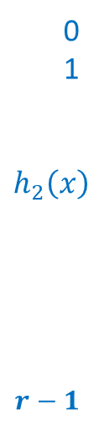




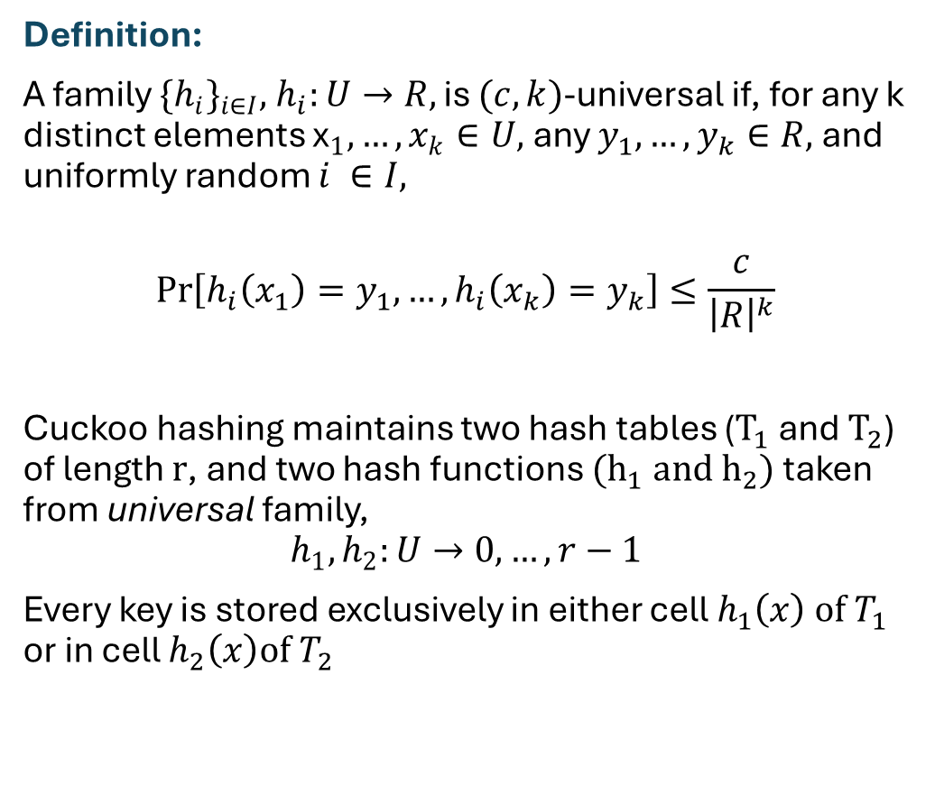


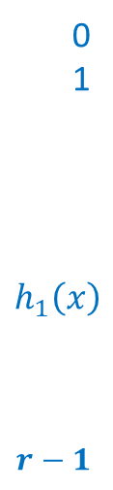

Setting up Cuckoo Hashing
Definition:
A family ${{\{h}_{i}\}}_{i∈I},$ $h_{i}:U→R,$ is $(c,k)$-universal if, for any k distinct elements ${\text{x}}_{1},…,x_{k}∈U,$any $y_{1},…,y_{k}∈R,$ and uniformly random $i ∈I,$
$$\operatorname{Pr}\left[h_{i}\left(x_{1}\right)=y_{1},…,h_{i}\left(x_{k}\right)=y_{k}\right]≤\frac{c}{{\left|R\right|}^{k}}$$
Cuckoo hashing maintains two hash tables ($T_{1}$ and $T_{2}$) of length $r$, and two hash functions $(h_{1} and h_{2})$ taken from universal family,
$$h_{1},h_{2}:U→0,…,r−1$$
Every key is stored exclusively in either cell $h_{1}\left(x\right) of T_{1}$ or in cell $h_{2}\left(x\right)of T_{2}$
$T$₁
$T$₂
0
1
$$h_{1}\left(x\right)$$
$$r−1$$
0
1
$$h_{2}\left(x\right)$$
$$r−1$$
$$x$$
$$⋮$$
$$⋮$$
$$⋮$$
$$⋮$$

Slide 7




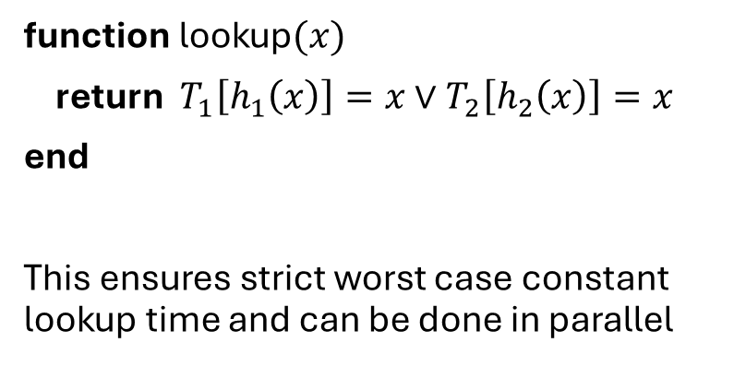



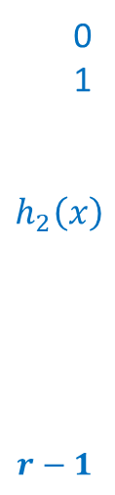
The Optimal Lookup
function lookup$(x)$
return ${ T}_{1}\left[h_{1}\left(x\right)\right]=x∨T_{2}\left[h_{2}\left(x\right)\right]=x$
end
This ensures strict worst case constant lookup time and can be done in parallel
Lookup$(x)$
$T$₁
$T$₂
$$x$$
0
1
$$h_{1}\left(x\right)$$
$$r−1$$
0
1
$$h_{2}\left(x\right)$$
$$r−1$$
$$⋮$$
$$⋮$$
$$⋮$$
$$⋮$$

Slide 8







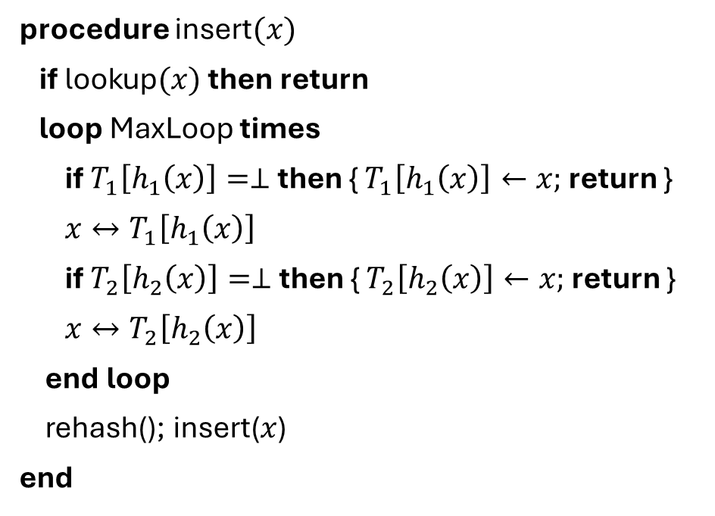
Insertion Procedure
procedure insert$(x)$
if lookup$(x)$ then return
loop MaxLoop times
if $T_{1}\left[h_{1}\left(x\right)\right]=⊥$ then { $T_{1}\left[h_{1}\left(x\right)\right]←x;$ return }
$x↔T_{1}\left[h_{1}\left(x\right)\right]$
if $T_{2}\left[h_{2}\left(x\right)\right]=⊥$ then { $T_{2}\left[h_{2}\left(x\right)\right]←x;$ return }
$x↔T_{2}\left[h_{2}\left(x\right)\right]$
end loop
rehash(); insert($x$)
end
Lookup$(x)$
$T$₁
$T$₂
0
1
$$h_{1}\left(x\right)$$
$$r−1$$
$$x$$
0
1
$$h_{2}\left(x\right)$$
$$r−1$$
$$s$$
$$t$$
$$u$$
$$z$$
$$y$$
$$v$$
We will now show that insertion takes constant time on expectation

Slide 9







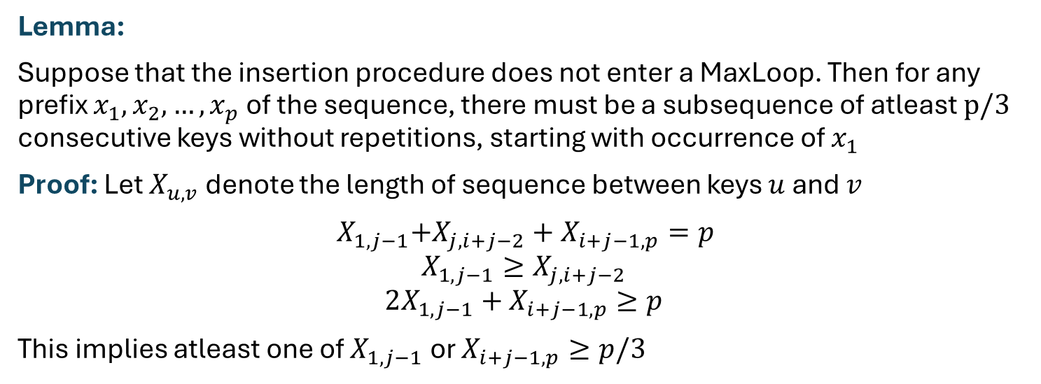











Behaviour of Insertion
$$x_{1}$$
$$x_{2}$$
$$x_{3}$$
$$⋮$$
$$x_{i}$$
$$x_{i+1}$$
$$⋮$$
$$x_{i+j}$$
$$x_{i+j−1}$$
$$x_{i+j−2}$$
$$x_{i+j−3}$$
$$⋮$$
$$x_{j}$$
$$x_{j−1}$$
$$⋮$$
Lemma:
Suppose that the insertion procedure does not enter a MaxLoop. Then for any prefix $x_{1},x_{2},…,x_{p}$ of the sequence, there must be a subsequence of atleast $p/3$ consecutive keys without repetitions, starting with occurrence of $x_{1}$
Proof: Let $X_{u,v}$ denote the length of sequence between keys $u$ and $v$
${ X}_{1,j−1}+X_{j,i+j−2}+X_{i+j−1,p}=p$
$$X_{1,j−1}≥X_{j,i+j−2}$$
$$2X_{1,j−1}+X_{i+j−1,p}≥p$$
This implies atleast one of $X_{1,j−1}$ or $X_{i+j−1,p}≥p/3$
$$x_{l}$$
$$MaxLoop$$
$$⊥$$

Slide 10



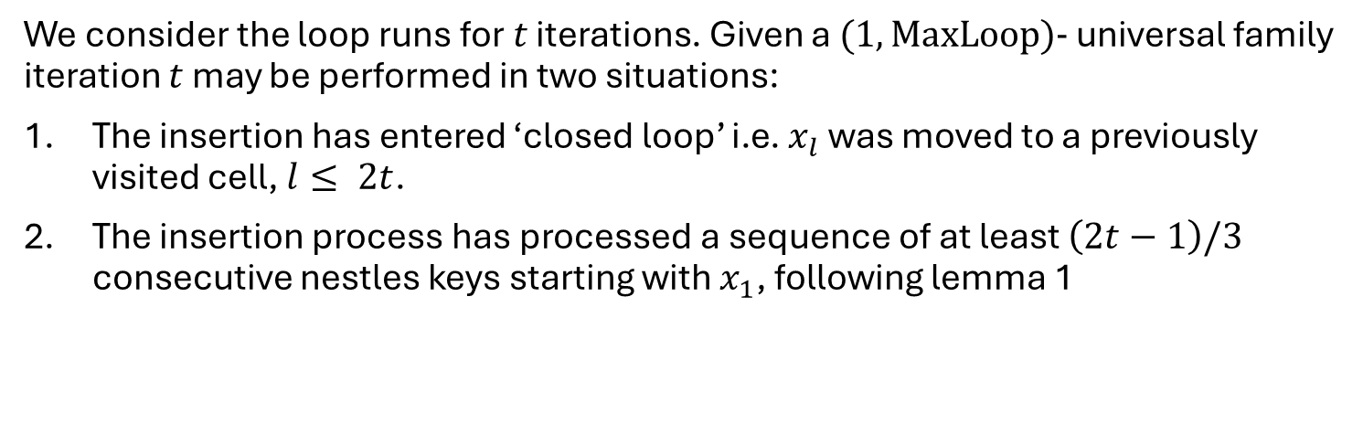


Probability bounds on Insertion
$$x_{1}$$
$$x_{2}$$
$$x_{3}$$
$$⋮$$
$$x_{i}$$
$$x_{i+1}$$
$$⋮$$
$$x_{i+j}$$
$$x_{i+j−1}$$
$$x_{i+j−2}$$
$$x_{i+j−3}$$
$$⋮$$
$$x_{j}$$
$$x_{j−1}$$
$$⋮$$
We consider the loop runs for $t$ iterations. Given a $(1,MaxLoop)−$ universal family iteration $t$ may be performed in two situations:
The insertion has entered ‘closed loop’ i.e. $x_{l}$ was moved to a previously visited cell, $l≤ 2t$.
The insertion process has processed a sequence of at least $\left(2t−1\right)/3$ consecutive nestles keys starting with $x_{1}$, following lemma 1
$$x_{l}$$
$$MaxLoop$$
$$⊥$$

Slide 11
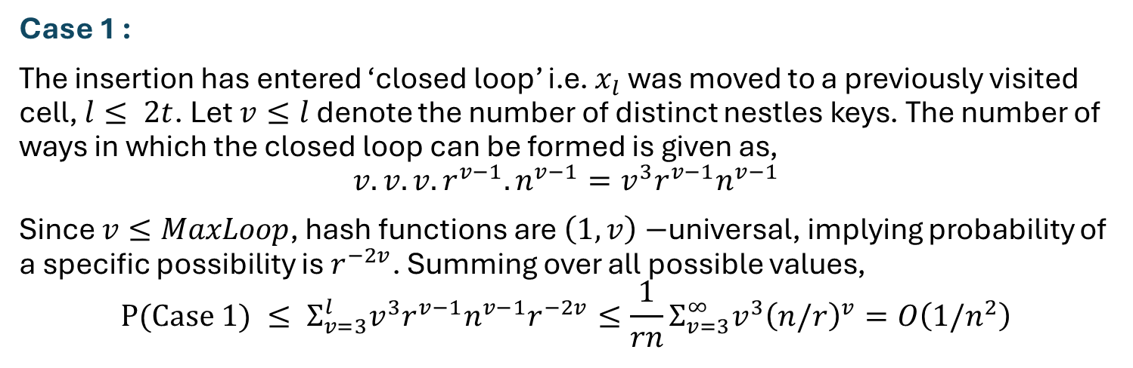
Probability bounds on Insertion
$$x_{1}$$
$$x_{2}$$
$$x_{3}$$
$$⋮$$
$$x_{i}$$
$$x_{i+1}$$
$$⋮$$
$$x_{i+j}$$
$$x_{i+j−1}$$
$$x_{i+j−2}$$
$$x_{i+j−3}$$
$$⋮$$
$$x_{j}$$
$$x_{j−1}$$
$$⋮$$
Case 1 :
The insertion has entered ‘closed loop’ i.e. $x_{l}$ was moved to a previously visited cell, $l≤ 2t$. Let $v≤l$ denote the number of distinct nestles keys. The number of ways in which the closed loop can be formed is given as,
$$v.v.v.r^{v−1}.n^{v−1}=v^{3}r^{v−1}n^{v−1}$$
Since $v≤MaxLoop$, hash functions are $\left(1,v\right)−$universal, implying probability of a specific possibility is $r^{−2v}$. Summing over all possible values,
$$P(Case 1) ≤ Σ_{v=3}^{l}v^{3}r^{v−1}n^{v−1}r^{−2v}≤\frac{1}{rn}Σ_{v=3}^{∞}v^{3}{\left(n/r\right)}^{v}=O\left(1/n^{2}\right)$$
$$x_{l}$$
$$MaxLoop$$
$$⊥$$

Slide 12

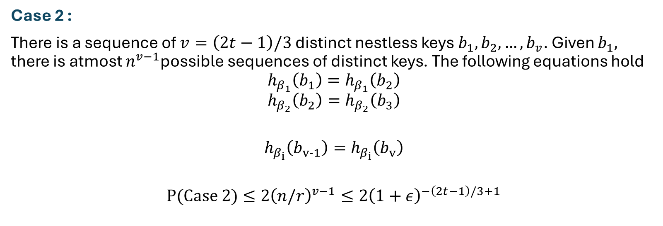

Probability bounds on Insertion
$$x_{1}$$
$$x_{2}$$
$$x_{3}$$
$$⋮$$
$$x_{i}$$
$$x_{i+1}$$
$$⋮$$
$$x_{i+j}$$
$$x_{i+j−1}$$
$$x_{i+j−2}$$
$$x_{i+j−3}$$
$$⋮$$
$$x_{j}$$
$$x_{j−1}$$
$$⋮$$
Case 2 :
There is a sequence of $v=\left(2t−1\right)/3$ distinct nestless keys $b_{1},b_{2},…,b_{v}$. Given $b_{1},$ there is atmost $n^{v−1}$possible sequences of distinct keys. The following equations hold
$$h_{β_{1}}\left(b_{1}\right)=h_{β_{1}}\left(b_{2}\right)$$
$$h_{β_{2}}\left(b_{2}\right)=h_{β_{2}}\left(b_{3}\right)$$
$$h_{β_{i}}\left(b_{v−1}\right)=h_{β_{i}}\left(b_{v}\right)$$
$$P(Case 2)≤2{\left(n/r\right)}^{v−1}≤2{\left(1+ε\right)}^{−\left(2t−1\right)/3+1}$$
$$x_{l}$$
$$MaxLoop$$
$$⊥$$
$$⋮$$
$$≤\frac{2n}{r}$$

Slide 13
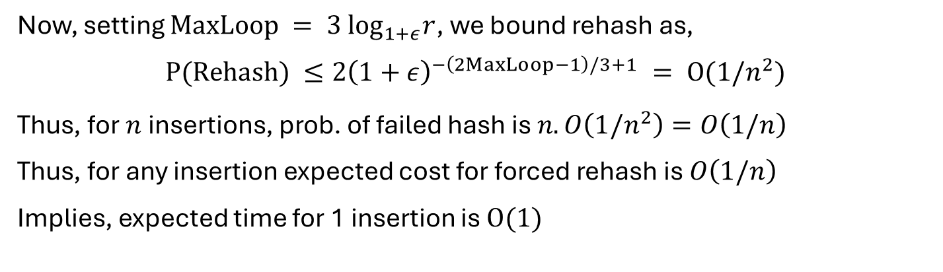
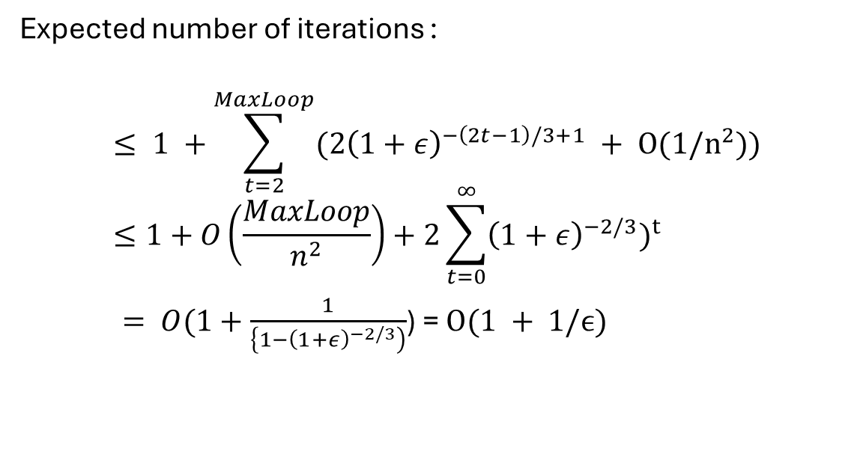
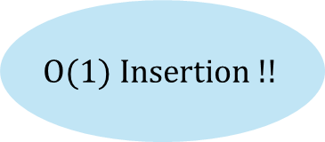
Concluding the analysis
Expected number of iterations :
$$≤ 1 +\sum_{t=2}^{MaxLoop}{(2{\left(1+ε\right)}^{−\left(2t−1\right)/3+1} + O(1/n^{2}))}≤1+O\left(\frac{MaxLoop}{n^{2}}\right)+2\sum_{t=0}^{∞}{{\left(1+ε\right)}^{−2/3})^{t}}$$
$= O(1+\frac{1}{\left\{1−{\left(1+ε\right)}^{−2/3}\right)}$) = $O(1 + 1/ϵ)$
Now, setting $MaxLoop = 3 \log_{1+ε}r$, we bound rehash as,
$$P(Rehash) ≤2{\left(1+ε\right)}^{−\left(2MaxLoop−1\right)/3+1} = O(1/n^{2})$$
Thus, for $n$ insertions, prob. of failed hash is $n.O\left(1/n^{2}\right)=O\left(1/n\right)$
Thus, for any insertion expected cost for forced rehash is $O\left(1/n\right)$
Implies, expected time for 1 insertion is $O(1)$
$$O(1) Insertion !!$$

Slide 14
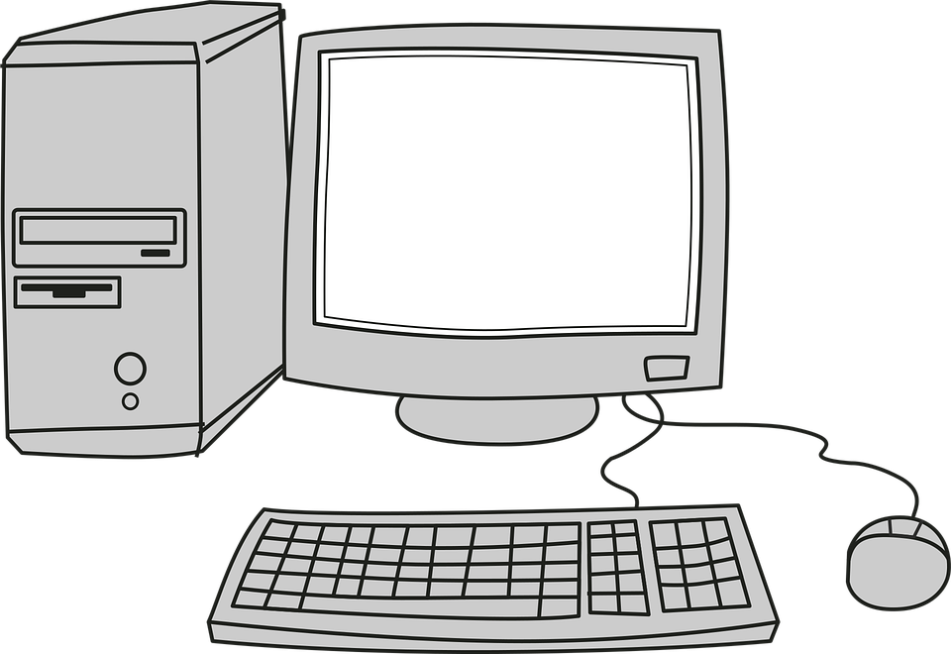
Experimental Setup
Hardware: Intel i7-10750H
Critical Spec: 12MB L3 Cache (Modern architecture)
Environment: C++23
Scale:
  2^{20} Table Slots (~1 Million Keys)
  5,000 trials per Load Factor point
  Total Execution: 3 Trillion Operations

Slide 15
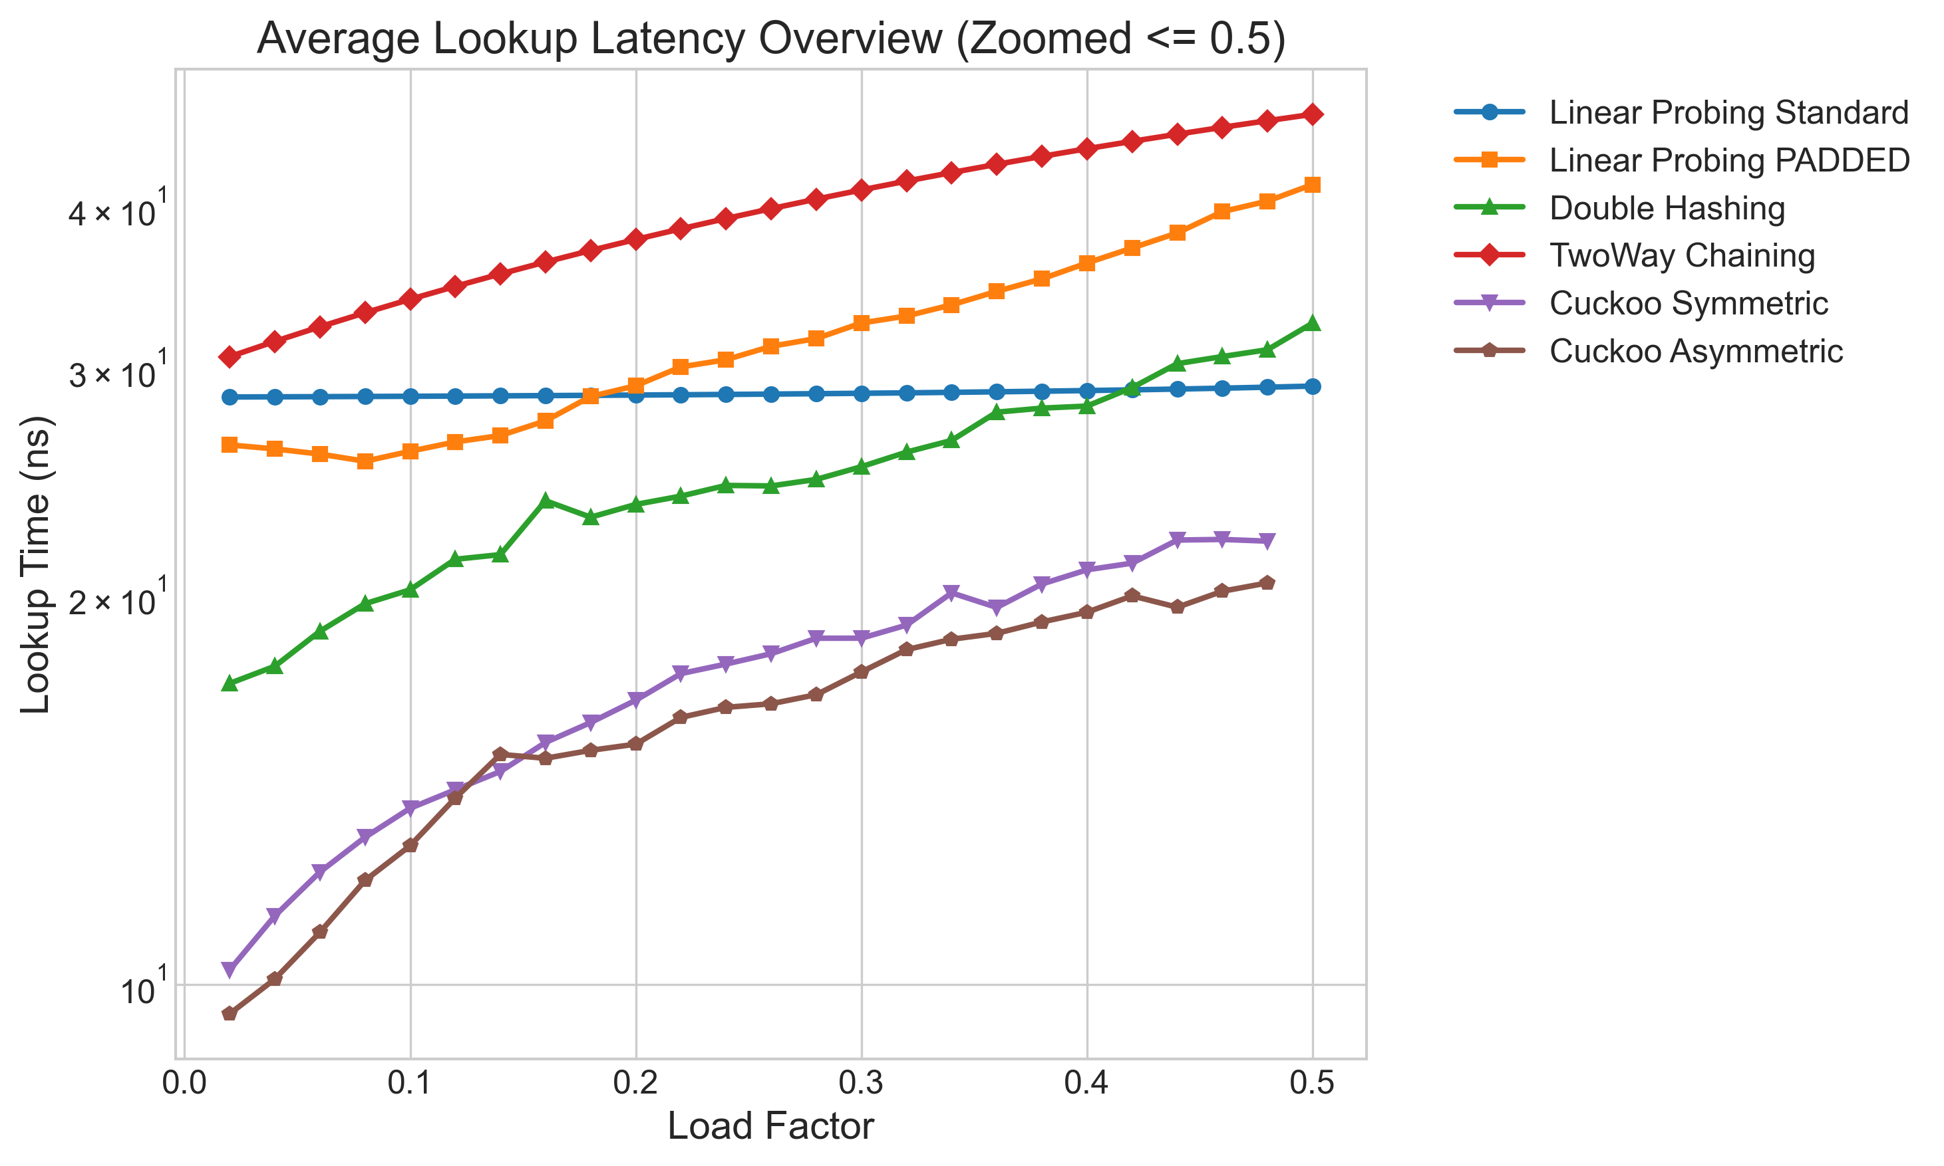
"We present a simple dictionary with worst case constant lookup time..." — Pagh & Rodler
The Problem: Open addressing degrades exponentially: 1/(1-alpha).
Our Setup: 3 Trillion operations, 2^{20} slots, 5,000 trials per point.
The Result: Linear Probing hits 800+ probes. Cuckoo Hashing remains mathematically capped at exactly 2 accesses.

Slide 16
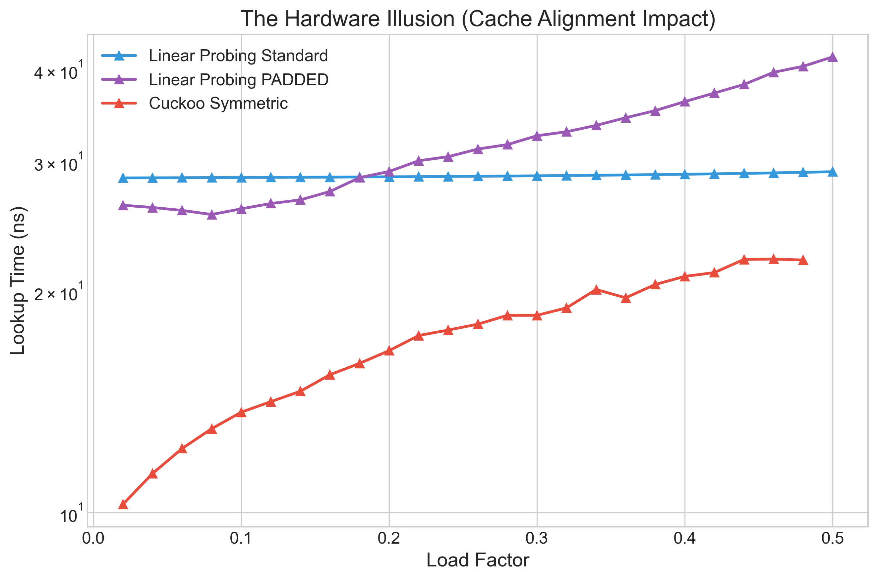
"In particular, the excellent cache usage of Linear Probing makes it a prime choice on modern architectures”
— Pagh & Rodler
L1 Cache Line: 64 Bytes
Linear Probing (Standard): Exploits spatial locality (free pre-fetching)
Linear Probing (Padded): Forced cache misses reveal true algorithmic cost
The Reality: Memory latency bottlenecks > CPU instructions

Slide 17
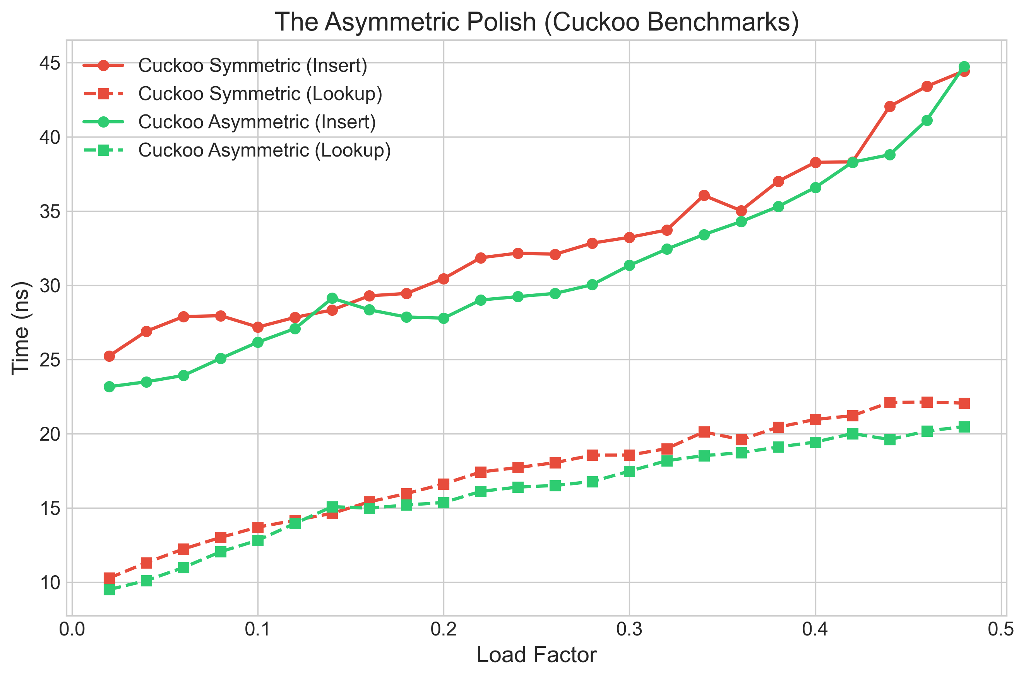
“After a long sequence of alternate insertions and deletions at load factor 1/3, we found that about 76% of the elements resided in the first table of Asymmetric Cuckoo, as opposed to 63% for Cuckoo Hashing”
— Pagh & Rodler
Symmetric (1:1): Equal table sizes.
Asymmetric (2:1): Primary table (T_1) is twice as large.
Advantage: Higher no. of keys settle in T_1 and hence found in 1 memory access.

Slide 18
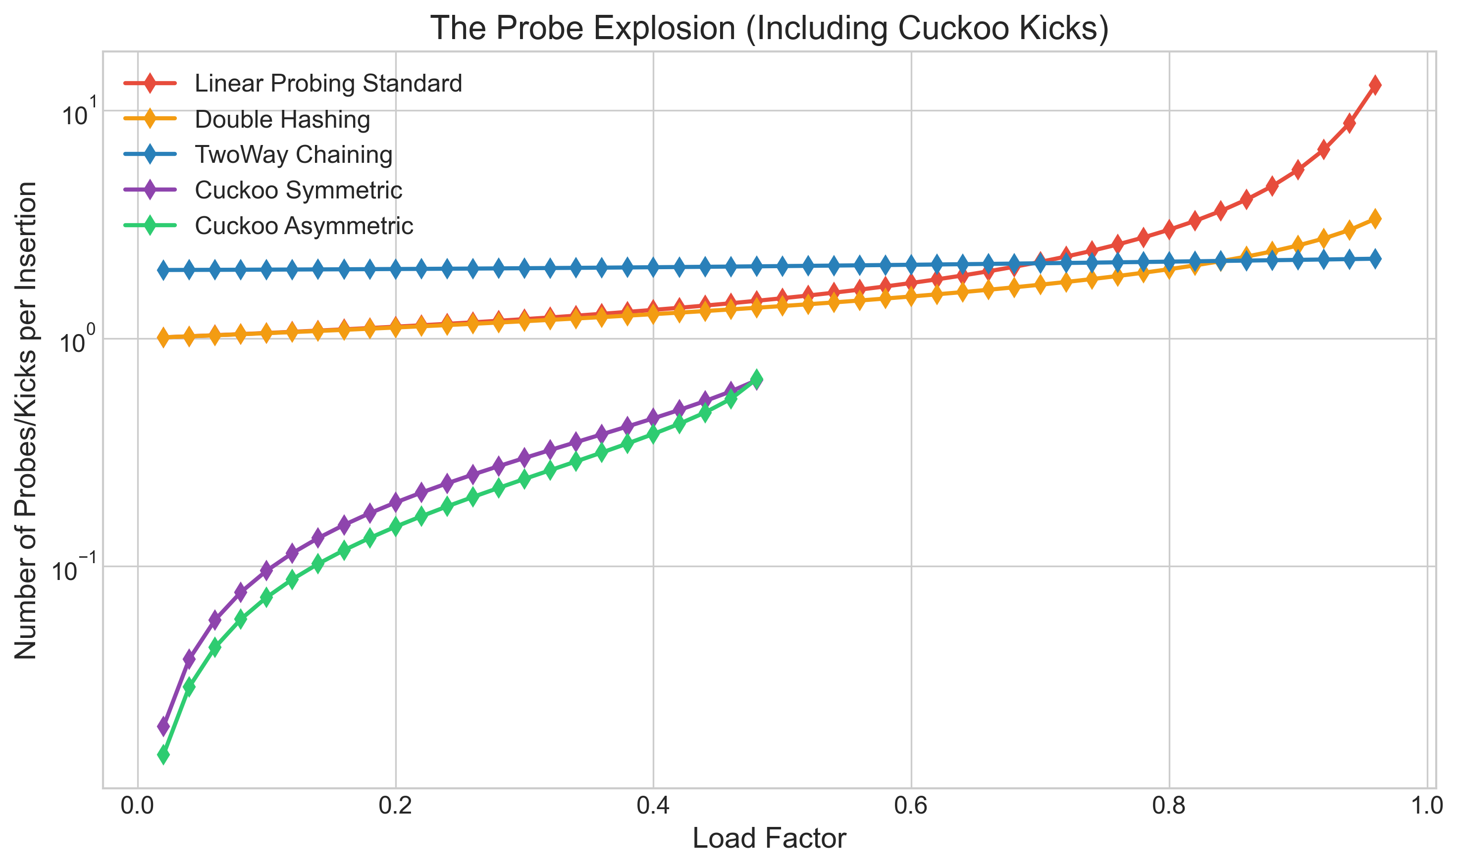
Cuckoo hashing bounds insertion kicks using a variable MaxLoop whereas open addressing techniques fall victim to expected longest probe sequences of log n that clump exponentially
Primary Clustering: Collisions generate unbreakable chains
The Open-Addressing Trap: Expected longest sequences approach log n
The Alternative: Cuckoo 'Kicks' elegantly bypass sequential congestion

Slide 19
Summary of Experiments
Based on our experiments and rigorous studies in the paper :-
Metric / Feature | Linear Probing | Two-Way Chaining | Cuckoo Hashing
Worst-Case Lookup | Bad (O(N)) | Variable (Chain Lengths) | Strictly O(1)
High Load Factor (90%+) | Catastrophic Probe Explosion | Stable | Hard mathematical ceiling (<50%)
Hardware / L1 Cache Usage | Excellent (Linear scans) | Poor (Pointer chasing) | Good (Independent hashes)
Space Overhead / Size | Excellent (No pointers) | Poor (Node allocation) | Moderate (Requires 2 tables)
Overall, Cuckoo Hashing is Superior

Slide 20
Thank you

